Slide 1


Maximizing
Productivity:
Hardness the
Power of Online
To-Do Lists
Projected by
Mahesh Chowdary(192211116)
Rishivarathan R.(192210601)
Jeevan Kumar G.(192211388)
Guided by DR.K.Jayasakthi Velmurugan

Slide 2

Aim:
In today’s fast-passed world, online to-do lists are essential for organizing tasks and boosting productivity. This presentation will explore the benefits and strategies for maximizing efficiency through digital task management.

Slide 3
EXISTITING
SYSTEM:
Features: Identify the features you need, such as task prioritization, deadlines, reminders, collaboration tools, and integrations with other apps.
Ease of Use: Choose a system that is intuitive and easy to use.
Platform Compatibility: Ensure the system is available on the platforms you use (e.g., web, mobile, desktop).
Collaboration: If you need to collaborate with others, choose a system that supports team collaboration.
Cost: Consider your budget and choose a system that offers the best value for your needs.

Slide 4
PROPOSED SYSTEM:
User-Friendly Interface:
Intuitive design with drag-and-drop functionality.
Customizable themes and layouts.
Accessible across devices (responsive web design, dedicated mobile apps).
Advanced Task Management:
Easy task input with options for quick tasks or detailed entries.
Use tags, labels, and categories to organize tasks.
Break down larger tasks into smaller, manageable subtasks.
Assign priority levels (e.g., low, medium, high).
3. Reminders and Notifications:
Set one-time or recurring reminders.
Receive timely alerts on mobile and desktop.
Optional email and SMS reminders for critical tasks.
4. Collaboration Tools:
Create and share task lists with team members or family.
Edit and update tasks in real-time with collaborators.
Add comments and attach files to tasks for better context.

Slide 5
ARCHITECTURE
Html, Css, Js and connected with DB
Register
Login
Homepage
TO-Do Page
Contact
Htm, Cs, and Js

Slide 6
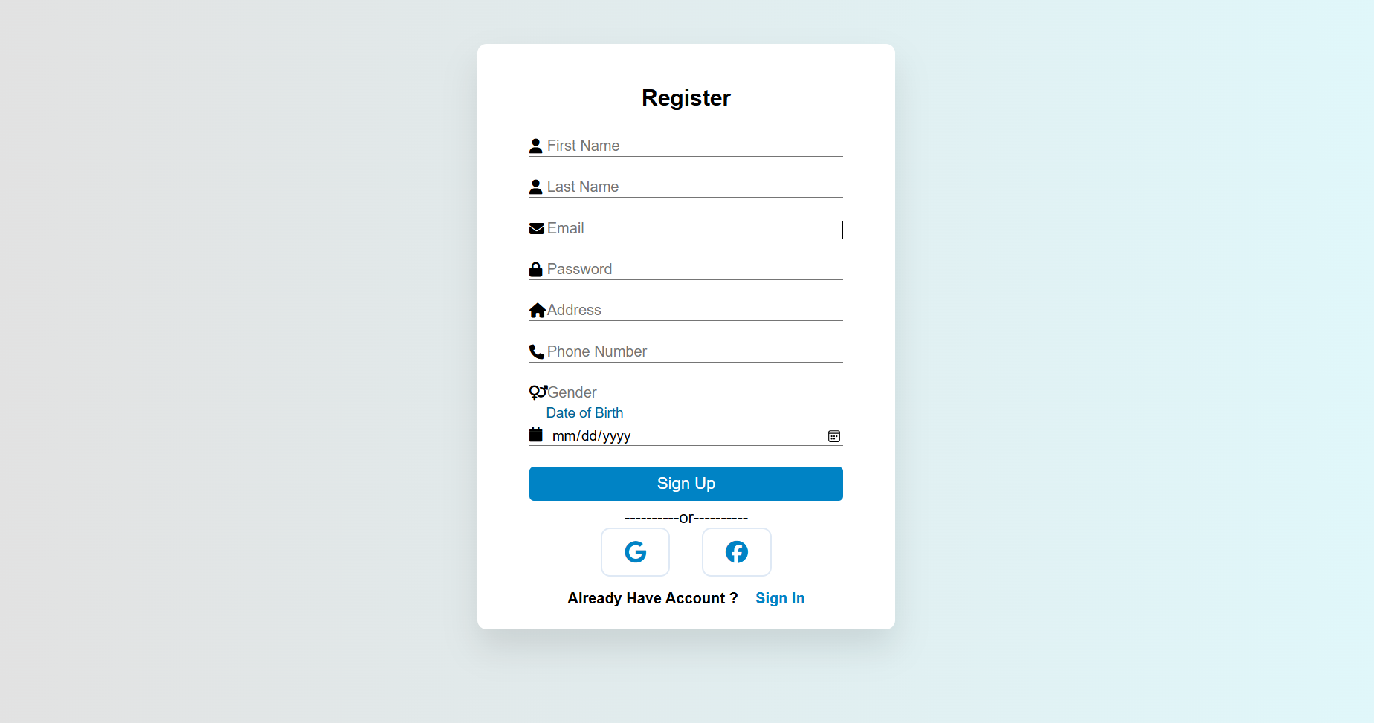
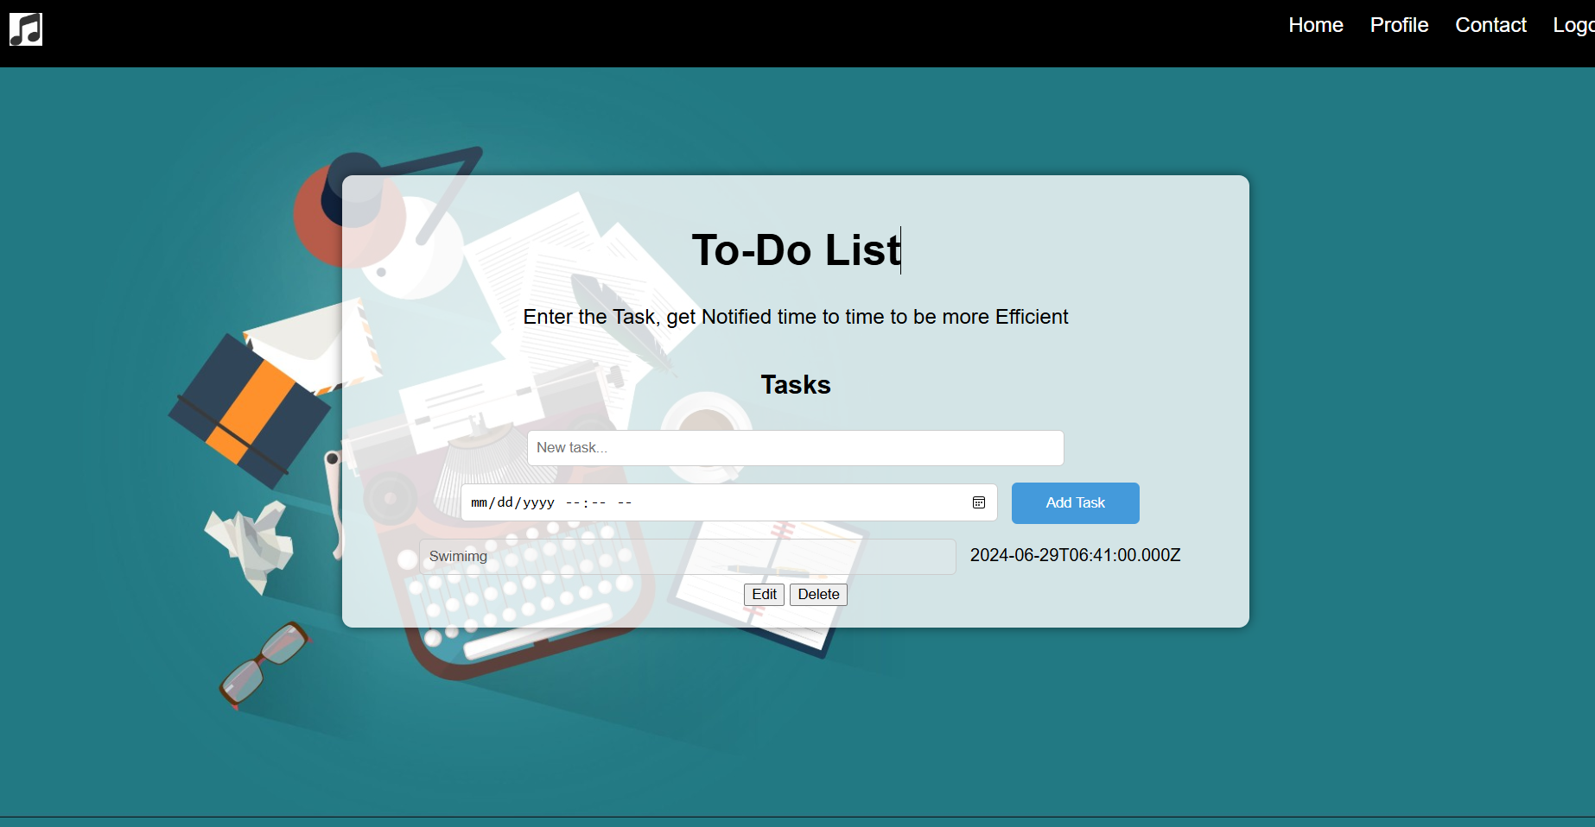
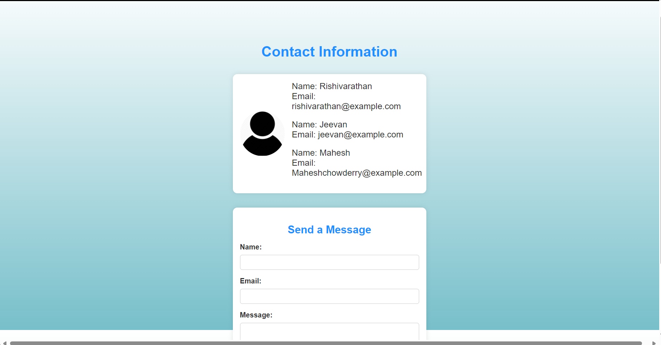
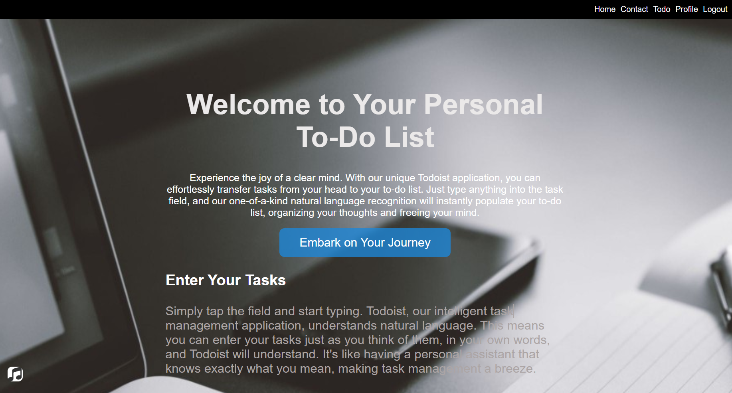
OUTPUT

Slide 7
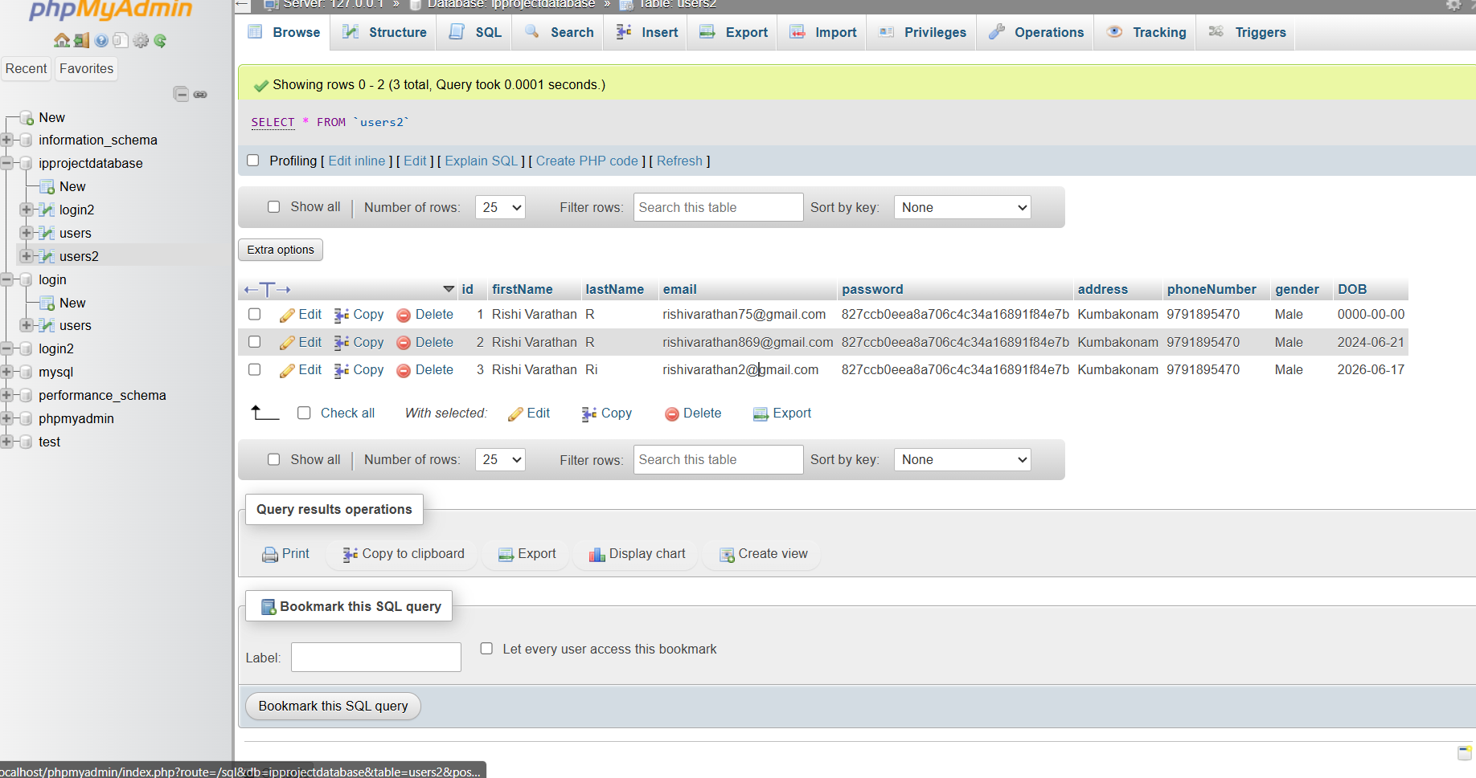
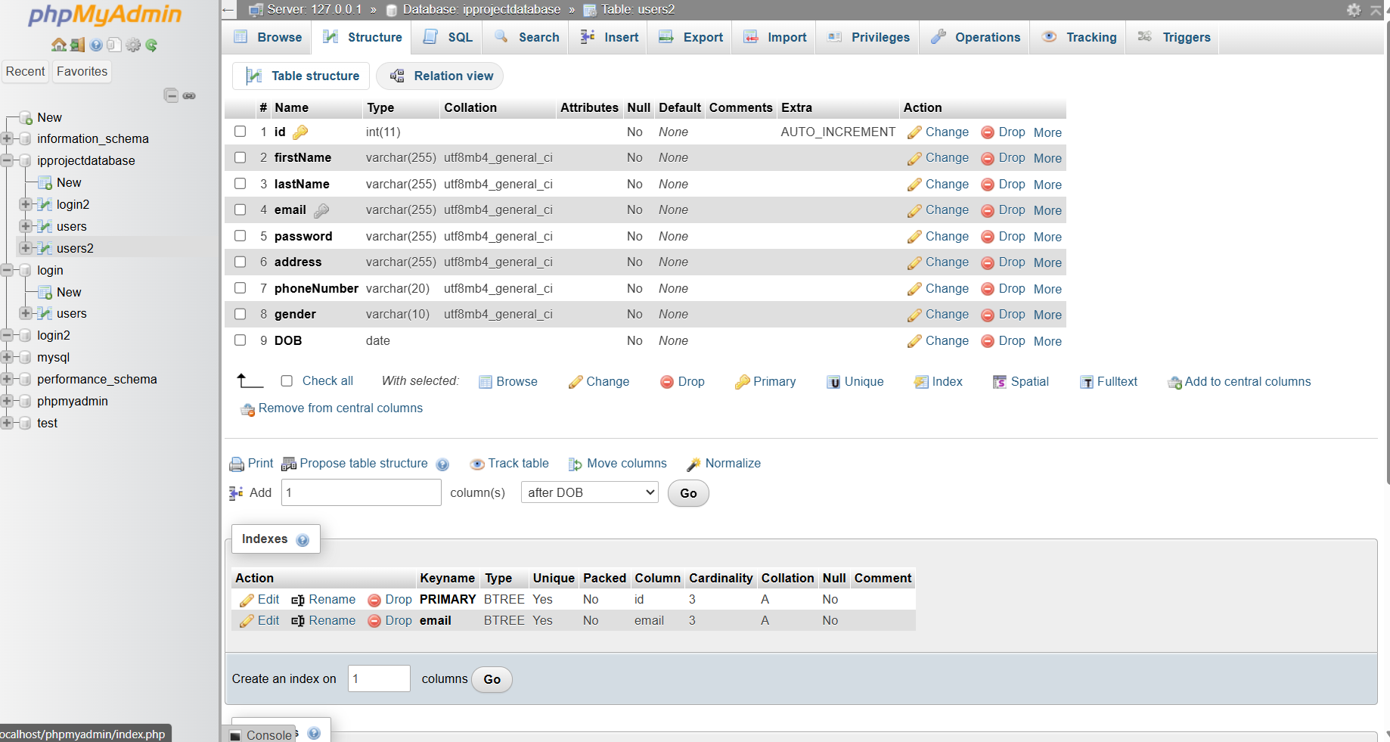
DATABASE

Slide 8
MODULE
JS
HTML
Php
Database
Mysql (Xampp)
CSS

Slide 9

CONCLUSION
In this model of To-Do list, we gave a full scope of UI, which making the interaction and Efficient for better than the previous.
Also to add an edge, we included a music to give a soothing style for a user to interact with. In such cases, We can give the task has we desire.
But, this doesn’t stop the futures interest on what it will become. More like adding an Ai to alter it just by voice input. And making it as conductor for to-do list orchestra.

Slide 10
Todoist - "Top 18 To-Do List Apps To Stay On Track in 2024" (2024, Hive)​ (Hive)​.Google Keep - "Top 18 To-Do List Apps To Stay On Track in 2024" (2024, Hive)​ (Hive)​.
Remember The Milk - "Top 18 To-Do List Apps To Stay On Track in 2024" (2024, Hive)​ (Hive)​.Trello - "14 Best To-Do List Apps of 2024 (Ranks & Honest Reviews)" (2024, FounderJar)​ (FounderJar)​.
Microsoft To Do - "14 Best To-Do List Apps of 2024 (Ranks & Honest Reviews)" (2024, FounderJar)​ (FounderJar)​.Any.do - "14 Best To-Do List Apps of 2024 (Ranks & Honest Reviews)" (2024, FounderJar)​ (FounderJar)​.
Notion - "14 Best To-Do List Apps of 2024 (Ranks & Honest Reviews)" (2024, FounderJar)​ (FounderJar)​.ClickUp - "Best To-Do List Apps for 2024:
Top 10 Tools Reviewed" (2024, Taskade)​ (Hive)​.TickTick - "Best To-Do List Apps for 2024: Top 10 Tools Reviewed" (2024, Taskade)​ (Hive)​.Asana - "Best To-Do List Apps for 2024: Top 10 Tools Reviewed" (2024, Taskade)​ (Hive)​.
REFERENCE

Slide 11

ANY QUESTIONS ?

Slide 12

THANK YOU

